Slide 1

Book Store Management Application

Slide 2





Project Objectives
Real-time Inventory
Maintain accurate stock levels
Secure Transactions
Multiple payment options
Role-Based Access
Admin & customer views
Insightful Reports
Data for decision-making
Personalized Recommendations
Boost sales & engagement
Our primary objective is to develop a comprehensive web application to automate and optimize all key bookstore processes.

Slide 3
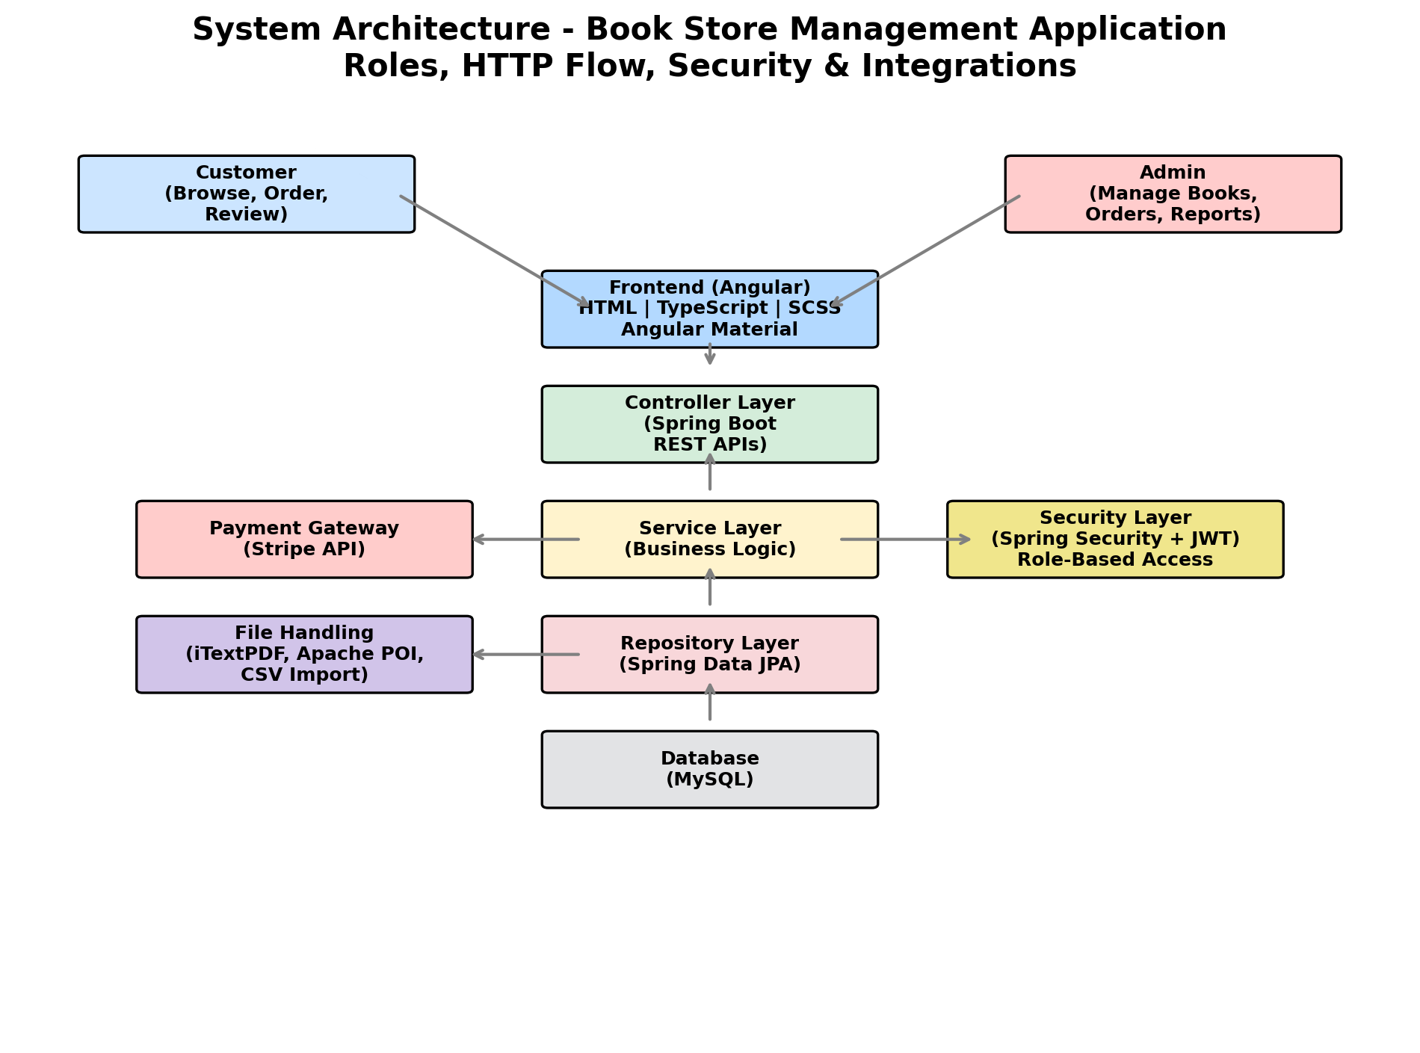
System Architecture
Our robust layered design ensures scalability, security, and maintainability.

Slide 4
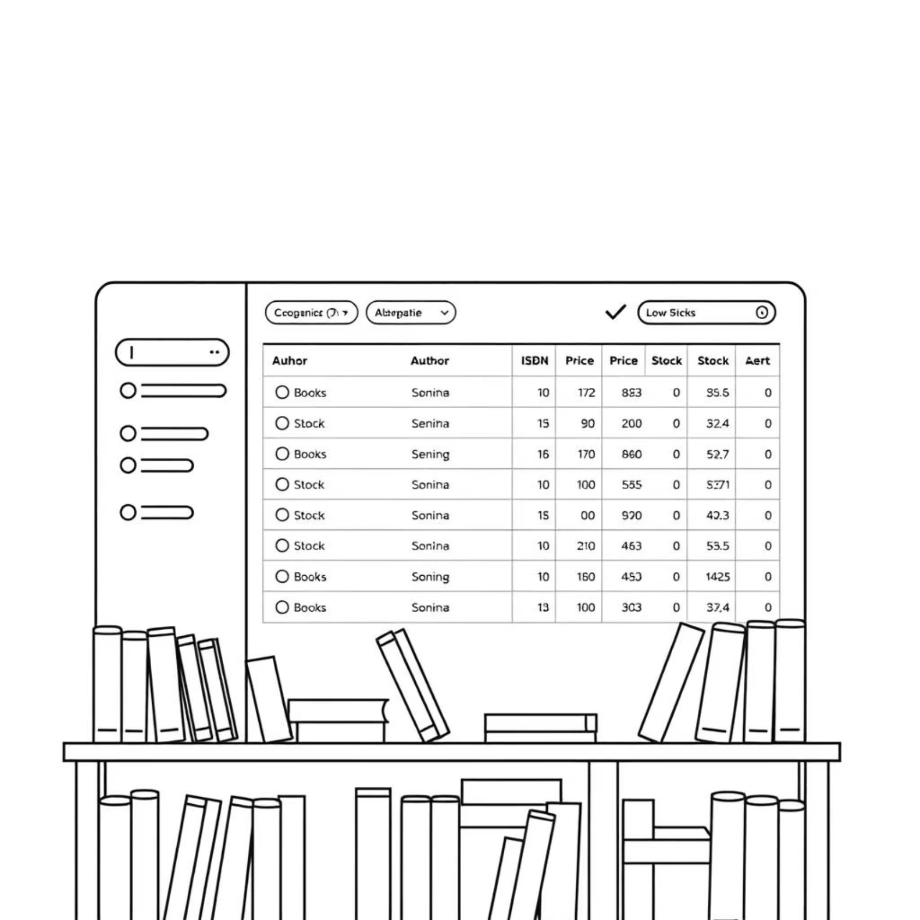
Module 1: Inventory Management
Full Book Metadata
Title, author, ISBN, price, stock
Auto Stock Updates
After sales or returns
Advanced Search & Filter
By title, author, genre, availability
Low Stock Alerts
Configurable thresholds
Bulk Import
CSV/Excel for quick setup

Slide 5





Module 2: User Management
Registration & Login
Role Management
Profile Management
Secure email/password authentication
Admin (full control) & Customer (browse, purchase)
Updates, password reset
Feedback & Reviews
Admin Dashboard
Customer ratings and comments
Active users & statistics

Slide 6

Module 3: Sales & Order Processing
Cart & Checkout
Payment Gateway
Order History
Invoice & Tracking
Seamless flow from browsing to delivery, ensuring customer satisfaction.

Slide 7

Module 4: Reporting & Analytics
Sales Reports: Daily, weekly, monthly trends
Inventory Reports: Bestsellers & low-stock alerts
Customer Insights: Active users, buying patterns
Revenue Tracking: By category & time
Export Options: PDF/Excel
Our robust reporting tools provide the data needed for smart business decisions, from optimizing stock to understanding customer preferences.
Fiction
Non-Fiction
Children's
Academic
Other

Slide 8

Module 5: Search & Recommendations
Advanced Search
Sorting & Filtering
By title, author, ISBN, genre
Price, year, rating, availability
Personalized Picks
Trending Books
Based on purchase history
Top-rated & most purchased

Slide 9






Tech Stack, Benefits & Future Scope
Technology Stack
Key Benefits
Frontend: Angular (HTML, CSS, TypeScript)
Streamlined Operations
Backend: Spring Boot (Java)
1
Database: MySQL
Improved accuracy & efficiency
Tools: Git, Postman
Security: Spring Security
Data-Driven Decisions
Payments: Stripe
2
Insights for strategic growth
3
Enhanced Engagement
Better customer experience
Future Enhancements
Mobile Application (Android/iOS)
AI-based Recommendation Engine
Multi-language & Multi-currency Support

Slide 10
Security Measures
Authentication & Authorization
Data Protection
Payment Security
HTTPS for secure transactions
Integration with secure payment gateways (PayPal, Razorpay, Stripe)
Spring Security with role-based access (Admin, Customer)
Input validation to prevent SQL Injection / XSS
Encrypted passwords (BCrypt)

Slide 11





Key Achievements
Multi-Payment Gateway
Bulk Data Import
Automated Invoicing
Successfully integrated support for various payment providers.
Developed efficient CSV/Excel import for book inventory.
Implemented automatic PDF invoice generation for orders.
Smart Search & Recs
Responsive Design
Built advanced search and personalized recommendations.
Delivered a UI optimized for desktops, tablets, and mobiles.

